Slide 1
Statistical Analysis
Topic: Characteristics of data sets
EQ: What are the main benefits of back to back stem and leaf plots?

Slide 2
Starter Activity
Have students measure themselves
Record these measurements on the board, separating by gender (keep this data for later use)
To start, have the students arrange these heights in a stem and leaf plot
Notes:
Teacher notes:
You can do this with any numerical data, doesn’t have to be height. I’m just lazy.

Slide 3
Characteristics of Data Sets EQ: What are the main benefits of back to back stem and leaf plots?
Summary:

Slide 4
Characteristics of Data Sets EQ: What are the main benefits of back to back stem and leaf plots?
Say we have the times for 20 male runners in the 100m:
10.8, 10.5, 11.3, 12.6, 13.1, 11.1, 11.2, 11.7, 11.2, 13.0, 12.3, 11.8, 11.5, 10.9, 10.7, 11.0, 11.1, 11.1, 12.1, 14.3
When we put this data in a stem and leaf plot, it looks like this:
Stem
Leaf
Stem
Leaf
10 8 5 9 7
3 1 2 7 2 8 5 0 1 1
12 6 3 1
13 1 0
14 3
10 5 7 8 9
0 1 1 1 2 2 3 5 7 8
12 1 3 6
13 0 1
14 3
Ordered
KEY
10|5 = 10.5 secs

Slide 5
Characteristics of Data Sets EQ: What are the main benefits of back to back stem and leaf plots?
20 women also ran 100m and their results are shown in the stem & leaf diagram below.
Stem
Leaf
Stem
Leaf
11 5 9
12 3 5 5 5 6 7 9 9
13 0 0 1 3 4 8 8
14 4 7
15 0
10 5 7 8 9
0 1 1 1 2 2 3 5 7 8
12 1 3 6
13 0 1
14 3
KEY
11|9 = 11.9 secs

Slide 6
Characteristics of Data Sets EQ: What are the main benefits of back to back stem and leaf plots?
Individually, it can be hard to compare the two data sets; it is just a bunch of numbers. That is where back to back stem and leaf plots are useful.
When comparing two sets of data, it is often more useful to draw a back-to-back stem & leaf plot
Back-to-Back stem & leaf diagrams share the same ‘stem’
Numbers closest to the ‘stem’ are smaller

Slide 7
Characteristics of Data Sets EQ: What are the main benefits of back to back stem and leaf plots?
Comparing the performances of the 20 men and women runners with a back to back stem and leaf gives us a better visual comparison.
WOMEN
MEN
Leaf
Stem
Leaf
9 5
9 9 7 6 5 5 5 3
8 8 4 3 1 0 0
7 4
0
10 5 7 8 9
0 1 1 1 2 2 3 5 7 8
12 1 3 6
13 0 1
3
KEY
11|9 = 11.9 secs

Slide 8
Characteristics of Data Sets EQ: What are the main benefits of back to back stem and leaf plots?
Going back to our starter activity, draw a back to back stem and leaf plot for the heights of the boys and girls.

Slide 9
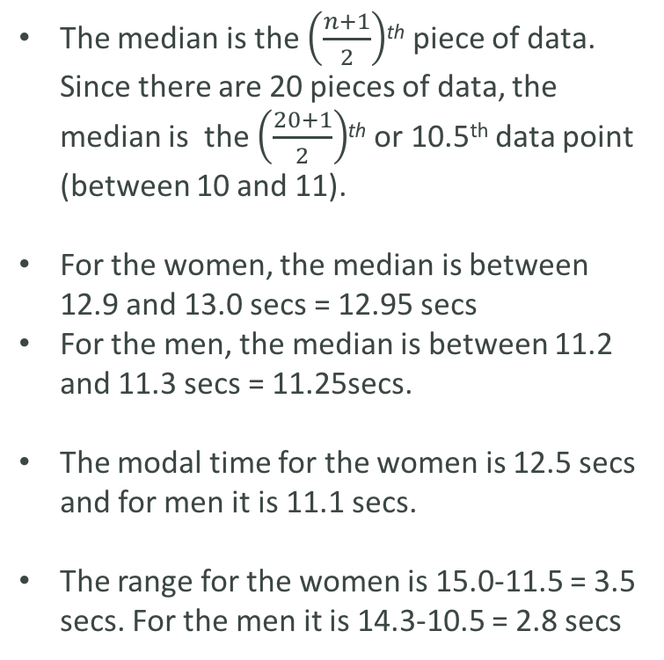
Characteristics of Data Sets EQ: What are the main benefits of back to back stem and leaf plots?
Looking at our 100m data sets, how can we find the median, mode and range of two data sets?
The median is the $\left(\frac{n+1}{2}\right)$^{th} piece of data. Since there are 20 pieces of data, the median is the $\left(\frac{20+1}{2}\right)$^{th} or 10.5th data point (between 10 and 11).
For the women, the median is between 12.9 and 13.0 secs = 12.95 secs
For the men, the median is between 11.2 and 11.3 secs = 11.25secs.
The modal time for the women is 12.5 secs and for men it is 11.1 secs.
The range for the women is 15.0-11.5 = 3.5 secs. For the men it is 14.3-10.5 = 2.8 secs
KEY
11|9 = 11.9 secs
WOMEN
MEN
Leaf
Stem
Leaf
9 5
9 9 7 6 5 5 5 3
8 8 4 3 1 0 0
7 4
0
10 5 7 8 9
0 1 1 1 2 2 3 5 7 8
12 1 3 6
13 0 1
3
10th
11th
10th
11th

Slide 10
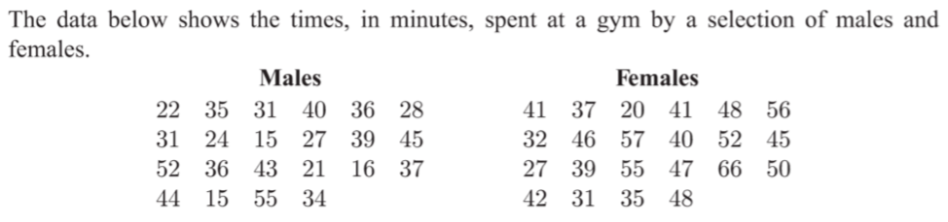
Characteristics of Data Sets EQ: What are the main benefits of back to back stem and leaf plots?
Display this data in a back to back stem and leaf plot
How many males spent less than 30 mins at the gym?
Find the median time spent at the gym for both males and females
In general, did males or females spend longer at the gym?

Slide 11
Characteristics of Data Sets EQ: What are the main benefits of back to back stem and leaf plots?
Going back to our starter activity, find the median, mode and range for the data sets of both genders
What do these results tell us about the heights of the boys and girls in our class? Write a 1-2 sentence summary, using mathematical language.

Slide 12
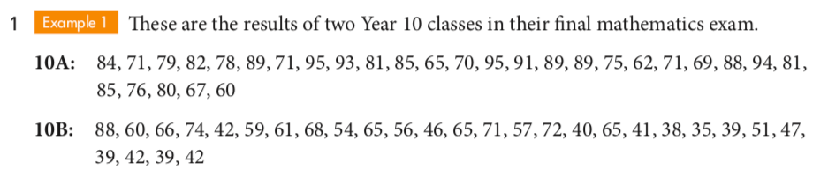
Characteristics of Data Sets EQ: What are the main benefits of back to back stem and leaf plots?
Draw a back-to-back stem and leaf plot for this data
How many students are in each class?
Find the median score for each class
Find the range for each class
If one class is the top class and one is the middle class, which is which and why?

Slide 13
Classwork/Exit Pass
Stem and Leaf Worksheet
Complete Exit Pass and hand to me when done

